Slide 1
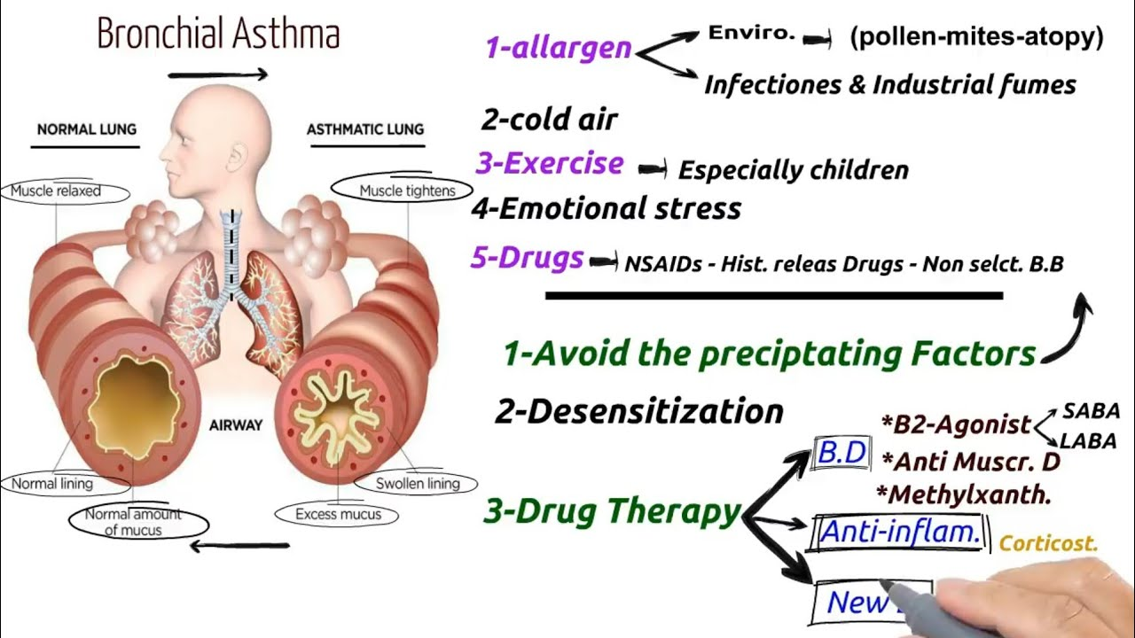
BRONCHIAL ASTHMA
BY
DR.G.AARTHIPRIYANKA
POST GRADUATE
DEPARTMENT OF PHARMACOLOGY

Slide 2
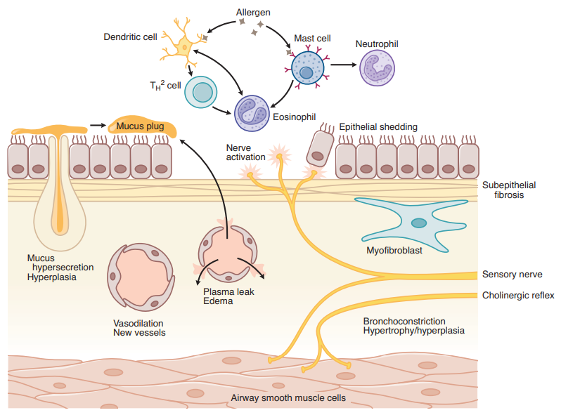
PATHOPHYSIOLOGY OF ASTHMA

Slide 3
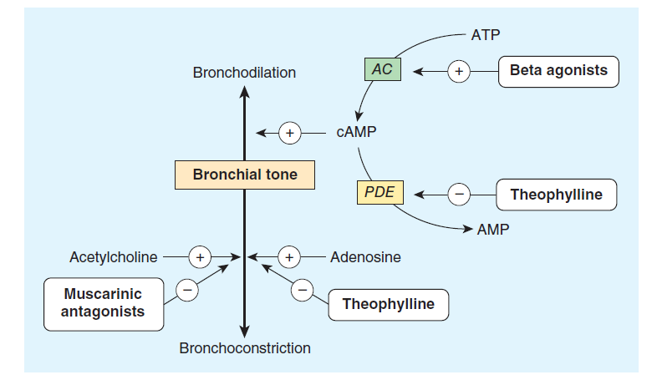
WAYS OF TREATING ASTHMA
Bronchodilatation
Preventing Bronchoconstriction (Broncho protection)

Slide 4
CLASSIFICATION
I.BRONCHODILATORS:
1.BETA-2 SYMPATHOMIMETICS 2.METHYLXANTHINES 3.ANTICHOLINERGICS
SHORT ACTING B2 AGONIST:
Salbutamol Theophylline Ipratropium bromide
Terbutaline Doxofylline Tiotropium bromide
LONG ACTING B2 AGONIST:
Salmeterol
Formoterol
ULTRA LONG ACTING B2 AGONIST:
Indacaterol

Slide 5
CLASSIFICATION
II.LEUKOTRIENE ANTAGONISTS:
Montelukast
Zafirlukast
III.MAST CELL STABILIZERS:
Sodium cromoglycate
Ketotifen

Slide 6
CLASSIFICATION
IV.CORTICOSTEROIDS:
1.SYSTEMIC 2.INHALATIONAL:
Hydrocortisone Beclomethasone dipropionate
Prednisolone Fluticasone propionate
Budesonide
V.Anti-IgE antibody: Ciclesonide
Omalizumab

Slide 7
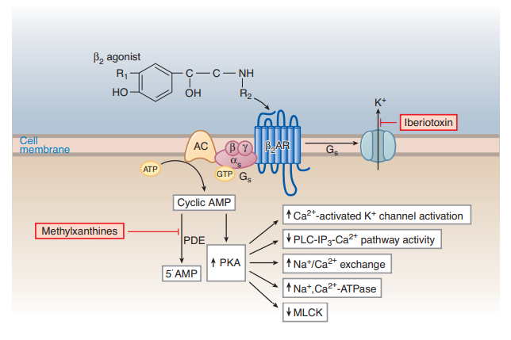
MECHANISM OF ACTION OF B2- AGONIST

Slide 8
BRONCHODILATORS-B2 AGONIST
SHORT ACTING B2 AGONIST:
SALBUTAMOL:
maximal within 15 minutes and
persists for 3–4 hours
DOSAGE FORMS:
metered-dose inhalers
Oral form-One tablet two or three times daily is the usual regimen
only terbutaline is available for subcutaneous injection (0.25 mg).
4-6 times daily – Safe, effective, inexpensive
DOC – Mild exacerbations
Each puff – 20 mins gap, Max- 4 puff if minimal improvement – needs steroids
STEREOSELECTIVE B2 AGONIST
B2 RECEPTOR POLYMORPHISMS

Slide 9
BRONCHODILATORS-B2 AGONIST
LONG ACTING B2 AGONIST:
SALMETEROL/FORMOTEROL
with 12-hour duration of action
high lipid solubility
ALWAYS USE – LABA + Corticosteroids –Why????
Twice daily
Immediate onset – formoterol, Delayed onset (inhalational) – Salmeterol
EXERCISE INDUCED ACUTE EXACERBATIONS – FORMOTEROL
Rate of development of tolerance is higher for formoterol
Why long acting – metabolism???

Slide 10
BRONCHODILATORS-B2 AGONIST
ULTRA LONG ACTING B2 AGONIST:
INDACATEROL:
only once a day
ALWAYS USE – ULABA + ICS –why???
prolonged bronchodilation masks symptoms of bronchial inflammation

Slide 11
COMBINATION INHALERS
Fluticasone + Salmeterol
Budesonide + Formoterol
Complementary synergistic action
Persistent asthma
ADVANTAGES-???

Slide 12
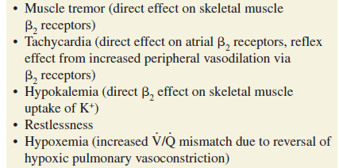
SIDE EFFECTS – B2 AGONISTS

Slide 13
TOLERANCE
Down regulation of B2 receptors
TOLERANCE – For what????
Corticosteroids prevent the development of tolerance – Airway smooth muscle but not broncho protective effect of inhaled b2 agonist

Slide 14
WHY NOT ADRENALINE,ISOPRENALINE,EPHEDRINE?
Side effects ???

Slide 15
METHYLXANTHINES
Theophylline, Theobromine, Caffeine
Doxofylline
MECHANISM OF ACTION:
Inhibit PDE
Inhibition of cell surface receptors for Adenosine
Enhancement of histone deacetylation
Interleukin-10 release
Effect on gene transcription –NF-kB
Apoptosis

Slide 16
THEOPHYLLINE
Narrow therapeutic Index
Less effective in improving PEFR

Slide 17
DOXOFYLLINE
Stable plasma concentration
Monitoring in hepatic dysfunction
Minimal toxicity – doesn't antagonize adenosine receptors
Improve PEFR

Slide 18
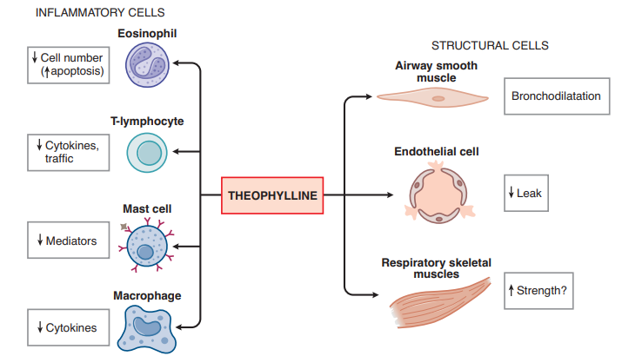
THEOPHYLLINE

Slide 19
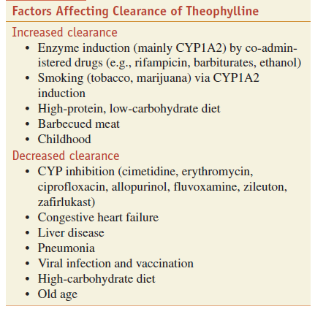

Slide 20
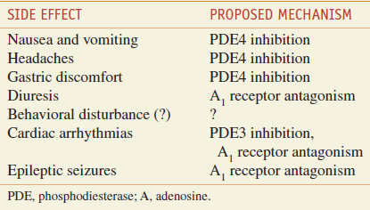
SIDE EFFECTS
NARROW THERAPEUTIC RANGE – 5-15mg/L
ADVANTAGE – Low cost
Tablets & Elixir

Slide 21
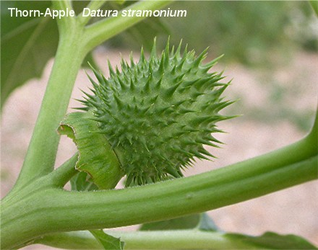
ANTI-CHOLINERGICS
Datura stramonium (Jimson Weed)
Atropine substitutes – Ipratropium bromide – 4-6 hrs
- Tiotropium bromide – 24 hours

Slide 22
IPRATROPIUM BROMIDE
Blocks M1,M2,M3
Blocking M2 is present
Slow onset – Max 30-60 mins, persists for 6-8 hours
3-4 times daily

Slide 23
TIOTROPIUM BROMIDE
Blocks M1,M2,M3
Prolonged binding with M1 & M3,easily dissociate from M2
Long acting
Once daily
Improves lung function – 4 year period

Slide 24
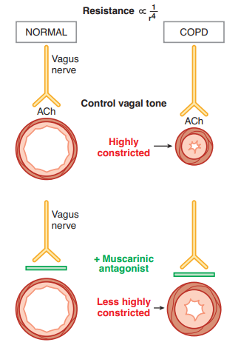
ANTI-CHOLINERGICS

Slide 25
ANTI-CHOLINERGICS
MDI – Ipratropium – 6-8 hours
DPI - Tiotropium
SIDE EFFECTS:
Paradoxical bronchoconstriction – ipratropium –why??/
Bitter taste
Glaucoma
Dry mouth

Slide 26
CORTICOSTEROIDS
They do not relax airway smooth muscle directly but reduce bronchial hyperreactivity and reduce the frequency of asthma exacerbations if taken regularly
beclomethasone,
budesonide,
ciclesonide,
fluticasone,
Methyl prednisolone

Slide 27
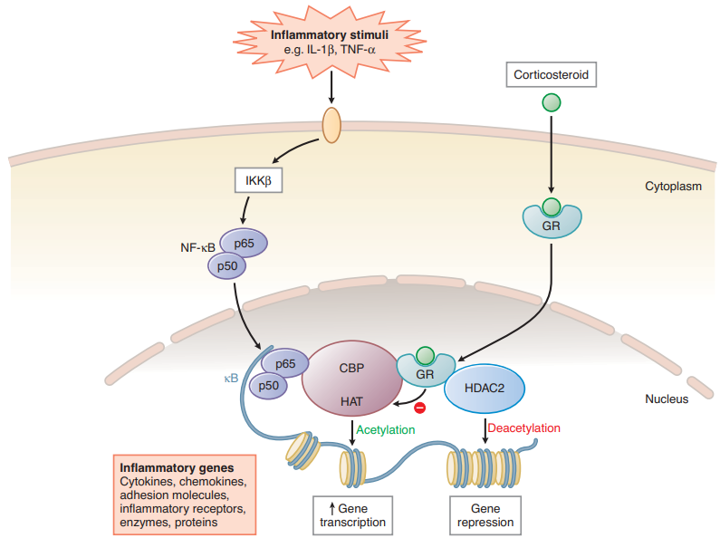
MECHANISM OF ACTION OF CORTICOSTEROIDS

Slide 28
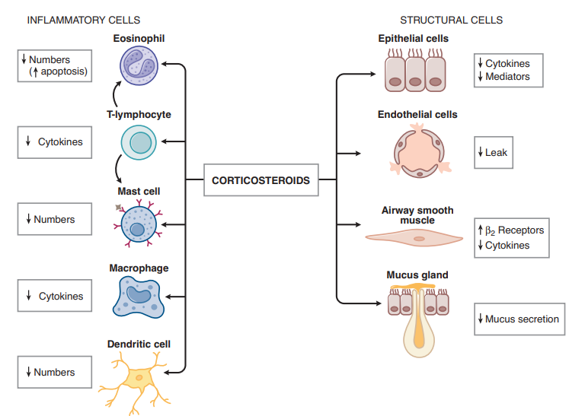
CORTICOSTEROIDS

Slide 29
ORAL CORTICOSTEROIDS
Prednisolone, prednisone
Several days – improvement
Given in morning - why???

Slide 30
FLUTICASONE PROPIONATE
Potent locally acting
No demonstrable side effects – Intranasal route
Lower than 1% systemic absorption
Virtually zero (<1%) oral bio availability
Improves PEF

Slide 31
BELOMETHASONE DIPROPIONATE
Prodrug
2% of drug – nasal passage
Suppresses nocturnal cortisol after 1 year of continuous use
Less PEF

Slide 32
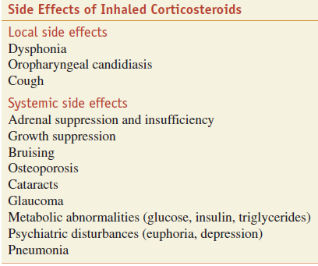

Slide 33
For severe asthma exacerbations, urgent treatment is often begun with an oral dose of 30–60 mg prednisone per day or
an intravenous dose of 0.5–1 mg/kg methylprednisolone every 6–12 hours; the dose is decreased after airway obstruction has improved.

Slide 34
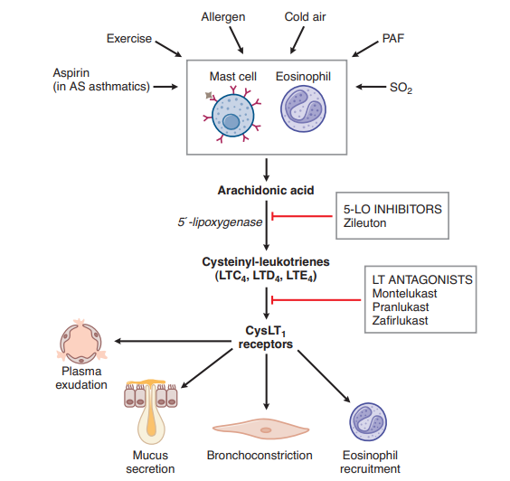
LEUKOTRIENES

Slide 35
ANTI-LEUKOTRIENES
Two approaches to interrupting the leukotriene pathway have been pursued:
inhibition of 5-lipoxygenase, thereby preventing leukotriene synthesis; and
inhibition of the binding of LTD4 to its receptor on target tissues, thereby preventing its action.
Of these agents, montelukast is by far the most prescribed,
because it may be taken without regard to meals, is taken once daily, and does not require periodic monitoring of liver function, as zileuton does.
They have the additional advantage of being effective when taken orally, which is an easier route of administration than aerosol inhalation in young children,
and montelukast is approved for children as young as 12 months of age.

Slide 36
SIDE EFFECTS
Rare – Hepatic dysfunction
- Churg - Strauss syndrome

Slide 37
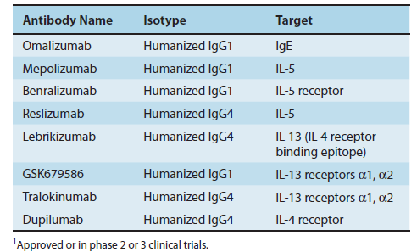
TARGETED (MONOCLONAL ANTIBODY) THERAPY

Slide 38
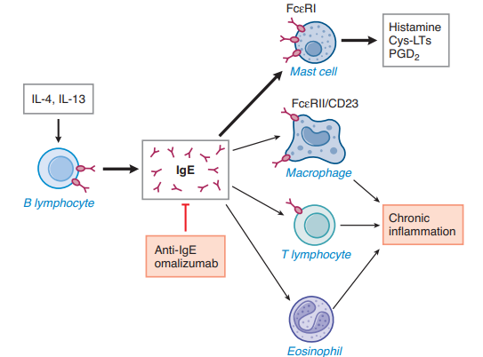
IMMUNOGLOBULINS

Slide 39
OMALIZUMAB
Omalizumab’s use is restricted to patients with severe asthma and evidence of allergic sensitization, and the dose administered is adjusted for total IgE level and body weight.
Administered by subcutaneous injection every 2–4 weeks to asthmatic patients, it lowers free plasma IgE to undetectable levels and significantly reduces the magnitude of both early and late bronchospastic responses to antigen challenge.
Omalizumab’s most important clinical effect is reduction in the frequency and severity of asthma exacerbations, while enabling a reduction in corticosteroid requirements.

Slide 40
MAST CELL STABLIZERS
Cromolyn sodium (disodium cromoglycate) and nedocromil sodium were once widely used for asthma management, especially in children, but have now been supplanted so completely by other therapies that they are mostly of historic interest as asthma treatments.
These drugs are thought to act by inhibiting mast cell degranulation and, as such, have no direct bronchodilator action
When taken regularly (2–4 puffs 2–4 times daily), these agents modestly but significantly reduce symptomatic severity and the need for bronchodilator medications, particularly in young patients with allergic asthma.
OTHER USES OF CROMOLYN:
allergic rhino conjunctivitis
systemic Masto cytosis

Slide 41
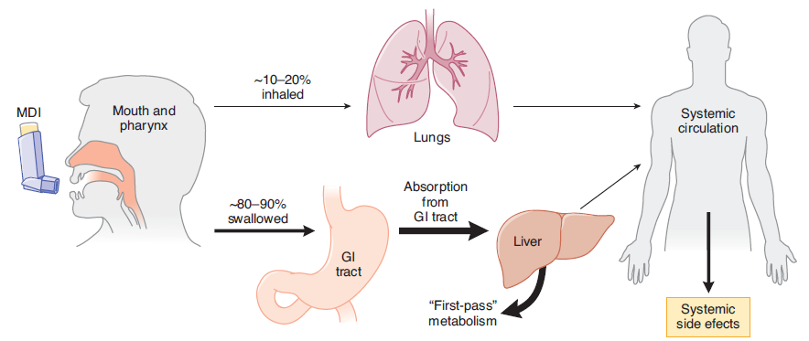
ROUTES OF DRUG DELIVERY TO THE LUNGS

Slide 42
B2 AGONIST- ROUTE
Inhalational – directed to site of action
- immediate onset
- <10microm particle size-smaller airways
Systemic – side effects (hypokalaemia)

Slide 43
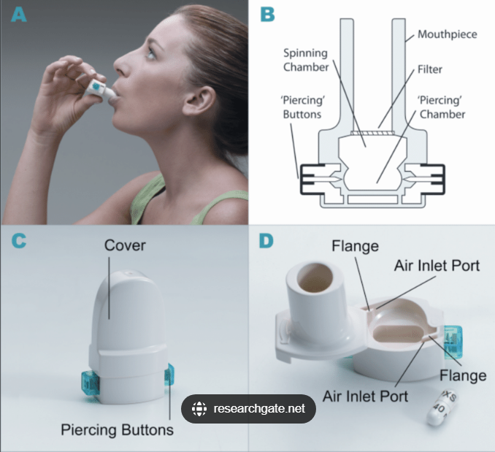
DPI
Environmentally safe – no propellant
Greater disposition in LRT
30-60% particles-enters into lungs
Main Advantage – very minimal
co-ordination
Difficult in children

Slide 44
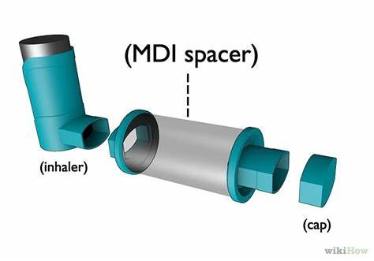
MDI
Hydrofluoroalkane
100-400 doses
Breath activated
Breath holding for 10 seconds
Other drugs- GTN, ergotamine
80%-mouth,10% canister,9%-lungs,1%-excluded

Slide 45
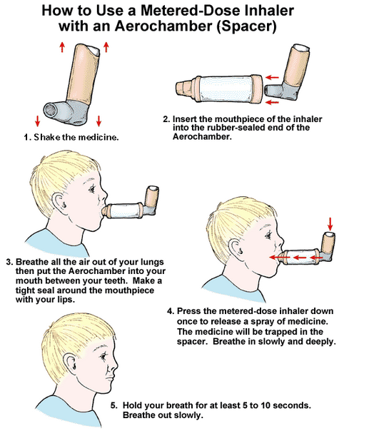
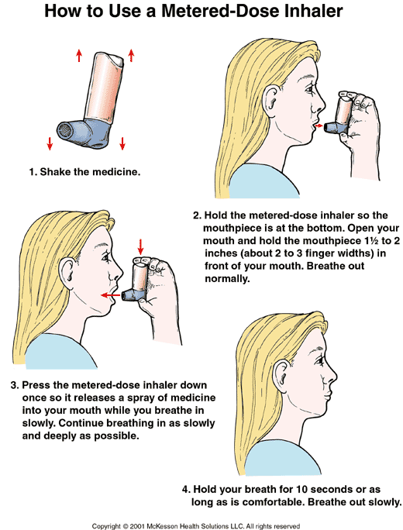

Slide 46
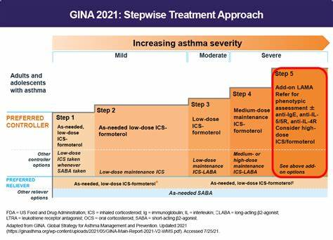

Slide 47
THANK YOU ALL

